Slide 2
detecting Covid-19 and Pneumonia with chest x-ray images using deep convolational neural network

Slide 3
A MINOR LOOKING INTO STATISTICS
Around the world:
Until 7h00, May 23rd 2021 (GMT +07), there are more than 167,02 millions Covid19 cases in total, s.t. more than 147,97 millions recovered cases and 3.467.879 deaths¹
Last 24 hours, the world has recorded more than 557 000 cases and more than 10 300 deaths
[1] According to worldmeters.info

Slide 4
A MINOR LOOKING INTO STATISTICS
Around Vietnam:
Until 18h 21st May 2021, it is recorded that there are 4941 cases, in which 2689 recovered cases and 41 deaths¹
=> It is urgent we take our actions to against this pandemic
[1] According to ncov.moh.gov.vn

Slide 5
Real Time Polymerase Chain Reaction

Slide 6
Real Time Polymerase Chain Reaction
Real time polmerase chain reaction (RT PCR) is a thermo-based DNA-cloning reaction. It can detect SARS-CoV-2 ribonucleic acid (RNA) from respiratory specimens (collected through nasopharyngeal or oropharyngeal swab)
Molecularly biological medical test RT PCR can be understood as a testing method detecting specific gene sequences within a complex mixture

Slide 7
Real Time Polymerase Chain Reaction
A high-reliability method
Since requiring dedicated machines in laboratories, RT PCR is only used when people are exposed to Covid19 due to the high time-consuming
The result is inconsistent
RT PCR takes a maximum cost up to 734 000 VNĐ per one examination (according to circular 5834/BYT-KH-TC)

Slide 8
Diagnostic imaging Covid19 via CXR

Slide 9
Diagnostic imaging Covid19 via CXR
Why ?
Diagnostic imaging is a relatively faster technique in comparison with the RT PCR
Lower cost, just more than 100 000 VNĐ per examination

Slide 10
Diagnostic imaging Covid19 via CXR
Why not ?
Difficulties in proper diagnosing with only chest X-ray (CXR) images, the technique itself requires other epidemiological characteristics and clinical manifestations for an improved accuracy
Mislead, then ambiguous between COVID-19 and pneumonia as a consequence

Slide 11
Diagnostic imaging Covid19 via CXR
Patient 4780’s case, according to Ministry of Medicine:
58-years-old patient living in district 3 went to Hòa Hảo Medic center for examining
The radiologist there, however, did mis-examine the patient as pneumonia instead of Covid19 through analyzing CXR and CT-scan images
-> Even experts in radiology might mis-examine the cases themselves

Slide 12
Diagnostic imaging Covid19 via CXR
Patient 4780’s case:
58-years-old patient living at district 3 went to Hòa Hảo Medic center for examining
The doctor there, however, did mis-examine the patient as pneumonia instead of Covid19 through analyzing CXR and CT-scan images
-> Thus, AI for this tailored specification is a high recommendation

Slide 13
Diagnostic imaging Covid19 via CXR
Why AI for diagnostic imaging with CXR images ?
Widespread test to identify positive cases first, then recheck by RT PCR
With individuals exposed with COVID-19 or got treatment, it is recommendation use X-ray diagnostic in the treating process until they are negative (with the X-ray diagnostic) and recheck by RT PCR
-> Lower cost
Economize the human resources

Slide 14
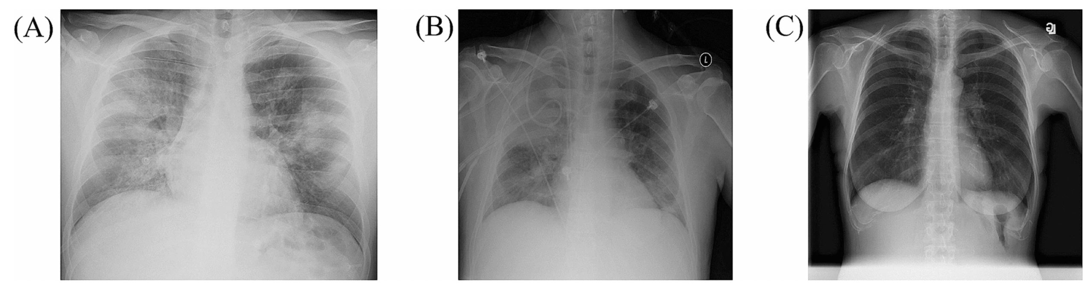
Certain features to classify Covid19 with Pneumonia
Representative CXR images of COVID-19 pneumonia (A), non-COVID-19 pneumonia (B), and the healthy (C)
Generally, similar to pneumonia, the density of lungs is increased in the case of COVID-19, which causes whiteness in the lungs on radiology^{[3]}
An experienced radiologist can confirm the disease by the appearance of a ground-glass pattern due to the increased whiteness
[3] Cleverley, J. et al. (2020)

Slide 15
Introduction to Covidx dataset^{[1-6]}

Slide 16
Dataset sources
[1] Wang, L., Lin, Z.Q. & Wong, A. COVID-Net: a tailored deep convolutional neural network design for detection of COVID-19 cases from chest X-ray images. Sci Rep 10, 19549 (2020). https://doi.org/10.1038/s41598-020-76550-z
[2] Cohen, J. P., Morrison, P., & Dao, L. COVID-19 image data collection. arXiv:2003.11597(2020)
[3] Chung, A. Figure 1 COVID-19 chest x-ray data initiative. https://github.com/agchung/Figure1-COVID-chestxray-dataset (2020)
[4] Chung, A. Actualmed COVID-19 chest x-ray data initiative. https://github.com/agchung/Actualmed-COVID-chestxray-dataset (2020)
[5] Radiological Society of North America. COVID-19 radiography database. https://www.kaggle.com/tawsifurrahman/covid19-radiography-database (2019)
[6] Radiological Society of North America. RSNA pneumonia detection challenge. https://www.kaggle.com/c/rsna-pneumonia-detection-challenge/data (2019).

Slide 18
COVIDx dataset
20 000 CXR images with 3 classes, which are pneumonia, COVID-19 and normal from different patients
[1] provides us a medical-images transfering tools to convert .MRI to .JPEG and combine [2-6] datasets into a consistent set with no unnecessary information

Slide 19
COVIDx dataset
Input: One CXR image
Output: Prediction of whether that patient is Pnemonia or COVID-19 or normal

Slide 20
Solving problem with Deep Convolutional Neural Network

Slide 21
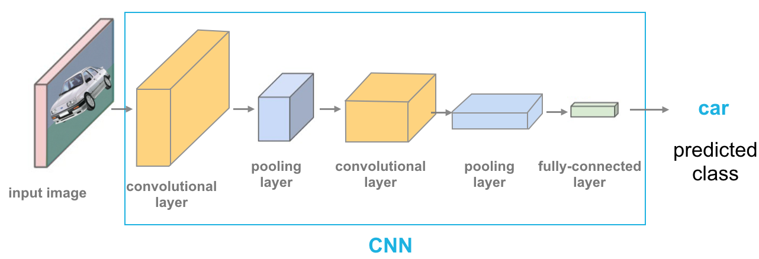
CNNs for classification ^{[7]}
Convolution: Apply filters to generate feature maps
Activation: Often ReLU
Pooling: Down sampling operation on each feature map
Train model with images data
[7] Krizhevsky et al. (2012)

Slide 22
Convolution operation
Learn weights of filters in convolutional layers

Slide 23
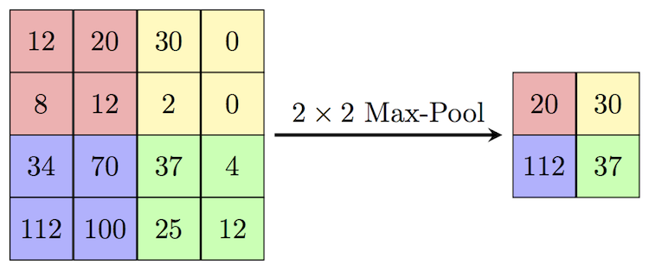
Pooling
Stride = 2
Reduce dimensionality
Spatial invariance

Slide 24

Feature learning
CONV and POOL layers output high-level features of input
Fully connected layer uses these features for classifying input image
Express output as probability of image belonging to a particular class

Slide 25
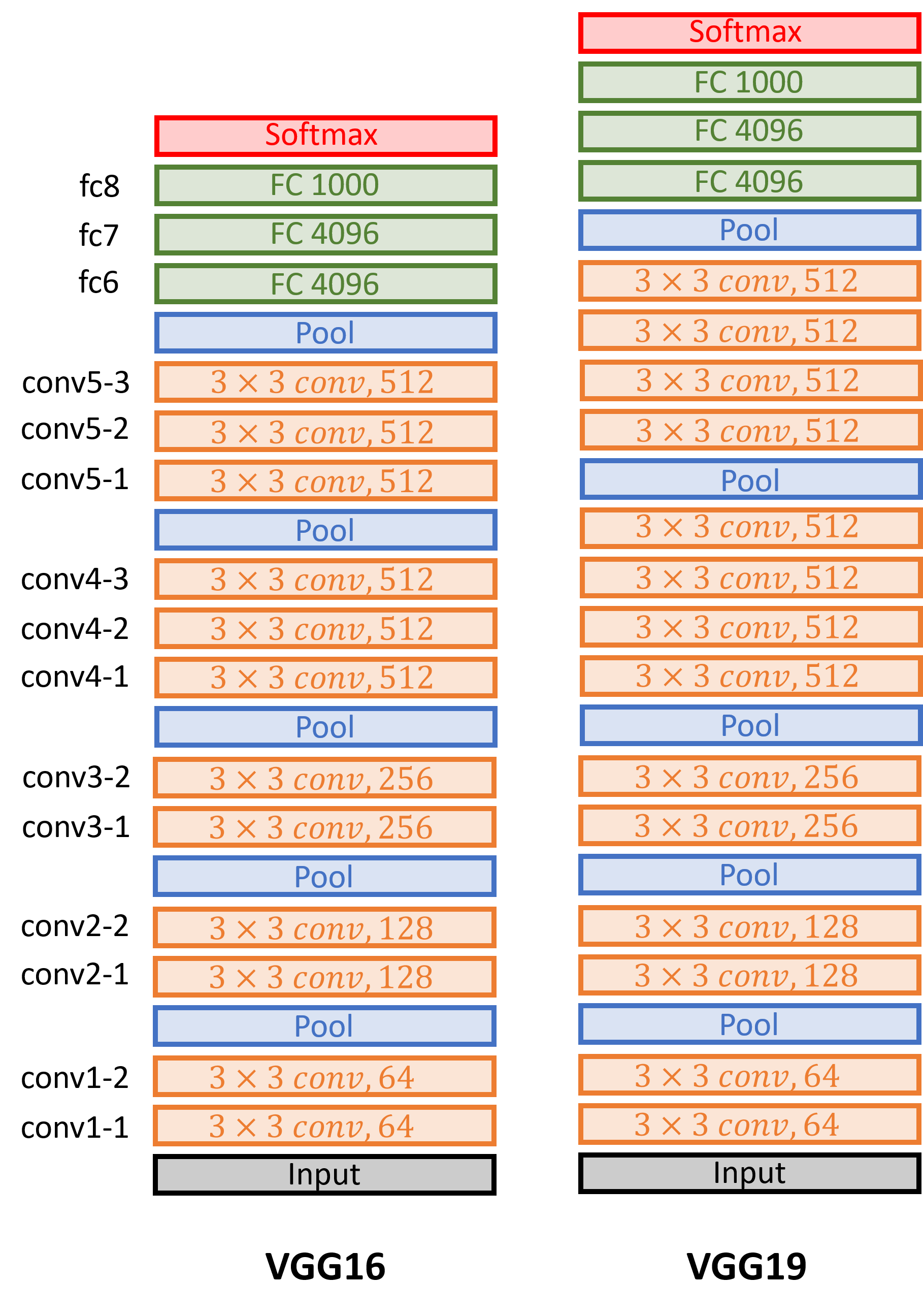
VGG19^{[11]}
[8] K. Simonyan et al., Very deep convolutional networks for large-scale image recognition, 2015.

Slide 26
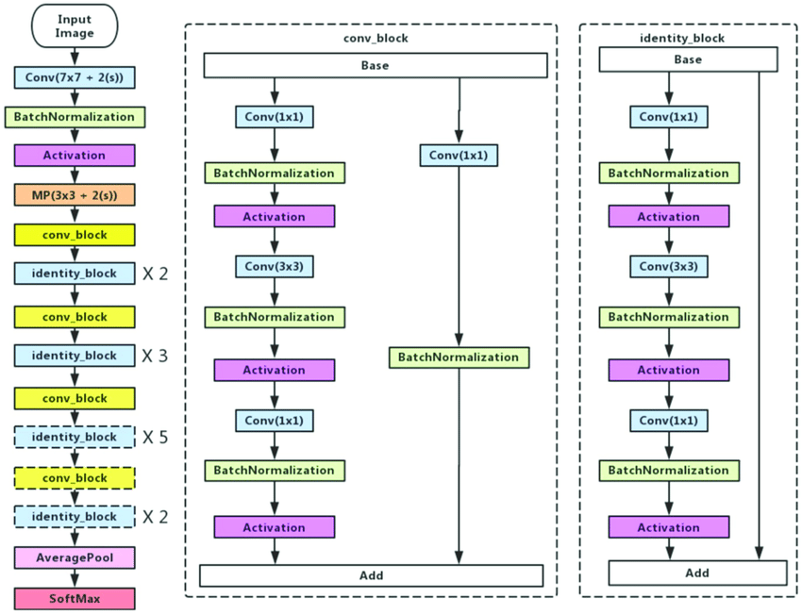
resnet50

Slide 27
Evaluating methods

Slide 28
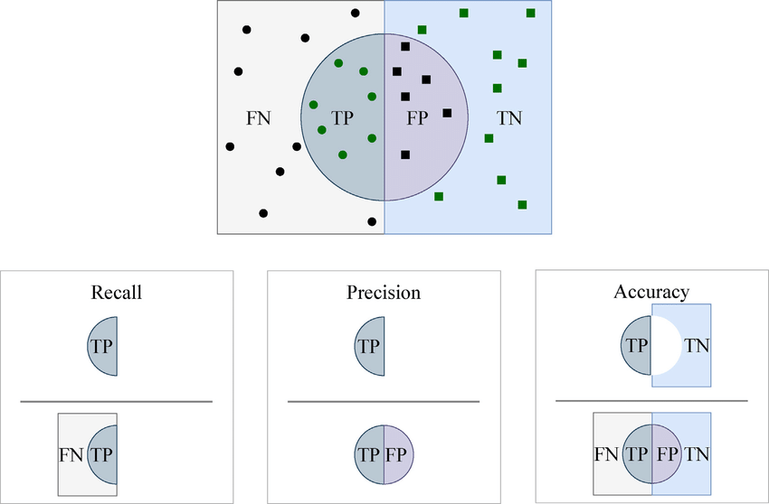
Sensitivity (recall): if a patient has the disease, what is the probability that the model predicts positive ?
Positive predictive value – PPV (precision): if a model prediction is positive, what is the probability that a patient has the disease ?

Slide 29

F1-score:
$$\frac{1}{\frac{1}{2} \left(\frac{1}{recall}+ \frac{1}{precision}\right)}$$

Slide 30
Future work

Slide 31
In reality, many COVID-19 patients has little or none damages around their lungs. Thus, their cases are classified as atype
For more persuasive, there is a should in using object detection problem
We also have to combine more data from patients for a better examination, e.g. age, race, gender, weight

Slide 32
References
[1] Cleverley, J.; Piper, J.; Jones, M.M. The role of chest radiography in confirming covid-19 pneumonia. BMJ 2020, 370.
[2] Wang, L., Lin, Z.Q. & Wong, A. COVID-Net: a tailored deep convolutional neural network design for detection of COVID-19 cases from chest X-ray images. Sci Rep 10, 19549 (2020). https://doi.org/10.1038/s41598-020-76550-z
[3] Cohen, J. P., Morrison, P., & Dao, L. COVID-19 image data collection. arXiv:2003.11597(2020)
[4] Chung, A. Figure 1 COVID-19 chest x-ray data initiative. https://github.com/agchung/Figure1-COVID-chestxray-dataset (2020)
[5] Chung, A. Actualmed COVID-19 chest x-ray data initiative. https://github.com/agchung/Actualmed-COVID-chestxray-dataset (2020)
[6] Radiological Society of North America. COVID-19 radiography database. https://www.kaggle.com/tawsifurrahman/covid19-radiography-database (2019)
[7] Radiological Society of North America. RSNA pneumonia detection challenge. https://www.kaggle.com/c/rsna-pneumonia-detection-challenge/data (2019).
[8] Krizhevsky, A., Sutskever, I. & Hinton, G. E. (2012). ImageNet Classification with Deep Convolutional Neural Networks. In F. Pereira, C. J. C. Burges, L. Bottou & K. Q. Weinberger (ed.), Advances in Neural Information Processing Systems 25 (pp. 1097--1105) . Curran Associates, Inc. .
[9] K. Simonyan et al., Very deep convolutional networks for large-scale image recognition, 2015.

